Slide 1
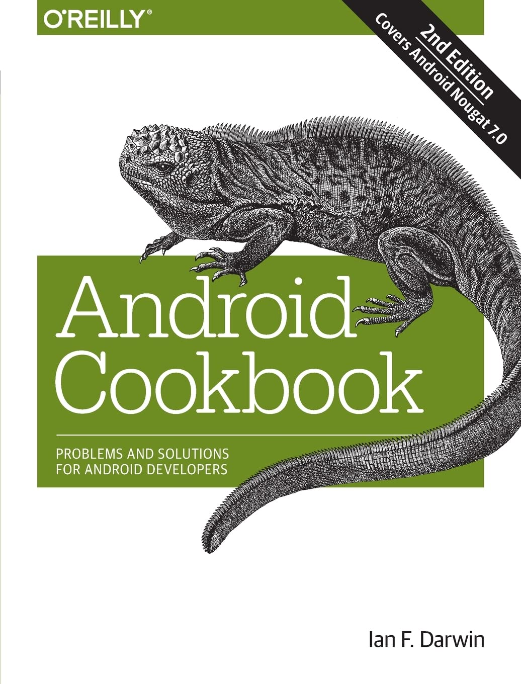
Android cookbook
Problems and solutions for
ANDROID DEVELOPERS
Ian F. Darwin

Slide 2



About:
Publication
ISBN No.
Edition
Cost
No. Of Pages
O’Reilly
978-93-5213-555-4
Second Edition
May 2017
Rs. 1800/-
741

Slide 3
With this book, you will:
Learn through the steps of setting up the Android Development Environment.
Learn to build a modal application (in particular Android Design) and testing the entire application in a well-controlled way.
Learn the concepts and architecture of a specific feature set, including views, maps, location-based services, persistent data storage, 2D and 3D graphics, media services, telephony services, and messaging.
Learn with ready-to-run example code that implements each feature in both XML and in few cases java-coded GUI development.
Learn to delve into advanced topics, such as security, custom views, performance analysis, and internationalization.

Slide 4
Review:
If you have any experience with writing java, using eclipse or xml then this book will patronize you to the nth degree.
This book explore the use of other programming language to write all or part of your Android Application includes C, Perl, Python, Lisp and other languages
Secondly there is no difference in this book than looking up online help and reading android documentation.
This practical book provides the concepts and code you need to develop software with Android
Through this book you will get to know Android Application Development which introduces you to the programming environment and offers you a complete working example that demonstrates Android architectural features and APIs.

Slide 5
Thank You
Rushikesh Pawal - Roll No. 13
Lakhan Balmiki - Roll No. 14

